Slide 1
MACHINE LEARNING PROJECT
Predicting the diagnosis of Type 2 Diabetes using Electronic medical records

Slide 2
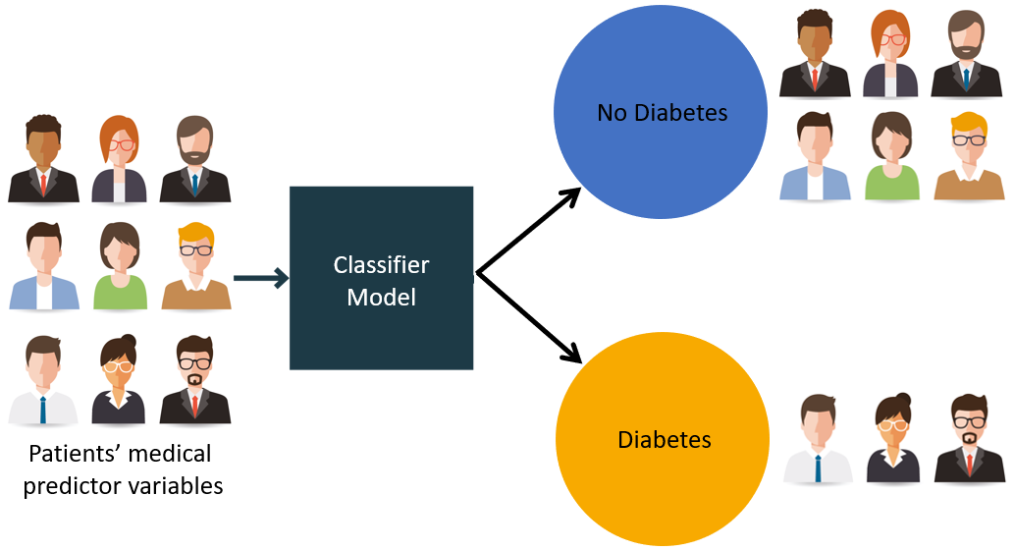
OBJECTIVE
The objective of this project is to build a predictive machine learning model to predict based on diagnostic measurements whether a patient has diabetes. This is a binary (2-class) classification project with supervised learning.

Slide 3

MOTIVATION
A small study has been conducted to analyse their medical records to assess if it is possible to predict the onset of diabetes based on diagnostic measures.
Diabetes is a common, chronic disease. Prediction of diabetes at an early stage can lead to improved treatment. Data mining techniques are widely used for prediction of disease at an early stage.
A small study has been conducted to analyse their medical records to assess if it is possible to predict the onset of diabetes based on diagnostic measures.

Slide 4
DATASET
The dataset used in this study, is originally taken from the National Institute of Diabetes and Digestive and Kidney Diseases (publicly available at: UCI ML Repository ). The main Objective of using this dataset was to predict through diagnosis whether a patient has diabetes, based on certain diagnostic measurements included in the dataset. Many limitations were faced during the selection of the occurrences from the bigger dataset. The type of dataset and problem is a classic supervised binary classification. The Pima Indian Diabetes (PID) dataset having: 9 = 8 + 1 (Class Attribute) attributes, 768 records describing female patients (of which there were 500 negative instances (65.1%) and 268 positive instances (34.9%)).
We can have another alternative for dataset. The dataset is downloaded from Kaggle, where all patients included are females at least 21 years old of Pima Indian heritage.

Slide 5
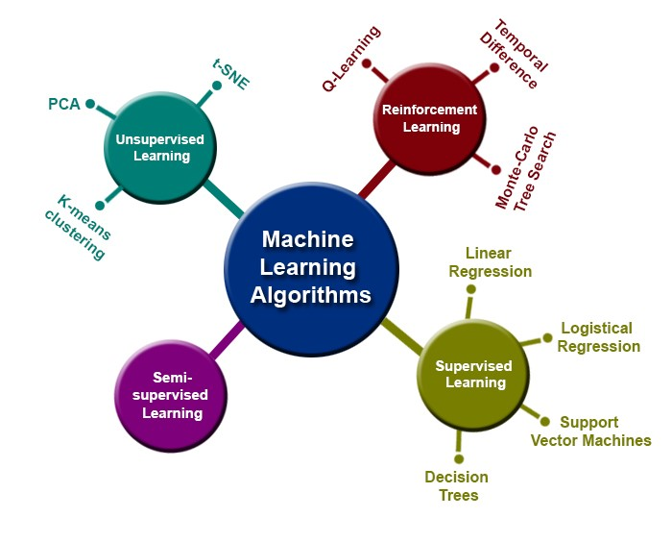
EXPECTED ALGORITHMS USED
Gaussian Naive Bayes
Bernoulli Naive Bayes
Multinomial Naive Bayes
Logistic Regression
K Nearest Neighbour
Decision Tree Classifier
Random Forest Classifier
Support Vector Classification (SVC)
Linear SVC
Neural Network

Slide 6
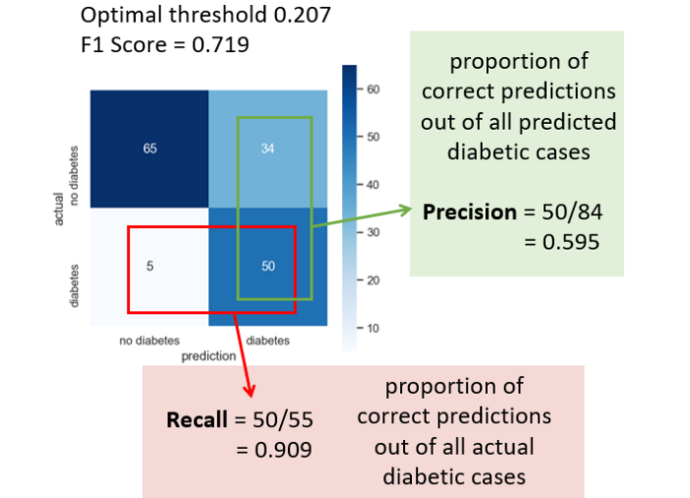
EXPECTED OUTCOME
The relevance of this classification project is NOT to mistakenly classify a diabetic patient as normal, so the focus should be on “Recall” metric. Gaussian Naive Bayes model has done very well (0.909).
Diabetes is a disease which can cause many complications. How to exactly predict and diagnose this disease by using machine learning is worthy studying.

Slide 7
APPLICATIONS
1.ML algorithms have been mainly used to classify diabetic prone cases for pre-diabetes, diabetes, and advanced diabetes based on the patients' HbA1c level.
2. The results demonstrate that AI methods are not only suitable for use in clinical practice but also self-management of diabetes. Also, these methods have the potential for improving patients' quality of life.

Slide 8

THANK YOU Made By- Sakshi Bhardwaj(48) Tushar Saxena(57)(Group Leader) Umesh Pratap Singh(58) Vipul(62)

